Slide 1

GROCERY SHOP WEBSITE
“Frontend Development”

Slide 2
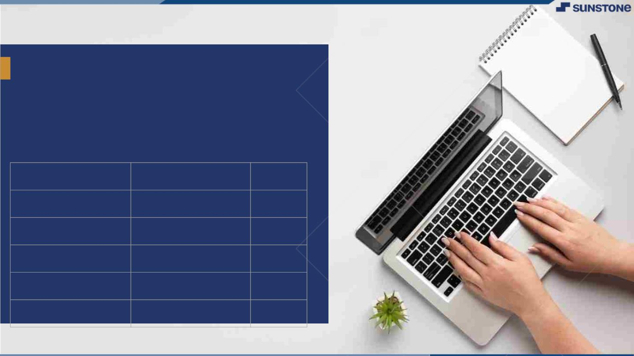
Grocery shop website:
The main purpose of this document to define the software requirements for a grocery shop system.
This system will facilitate a management of inventory, customer,transactions and employee tasks in grocery store.
NM ID | NAME | BATCH
au421320104011 | Hariharasudhan K | 11
au421320104032 | Ranjith V | 11
au421320104036 | Saravanan B | 11
au421320104050 | Vigneshwaran S | 11
au421320104302 | Mahesh Kumar D | 11

Slide 3
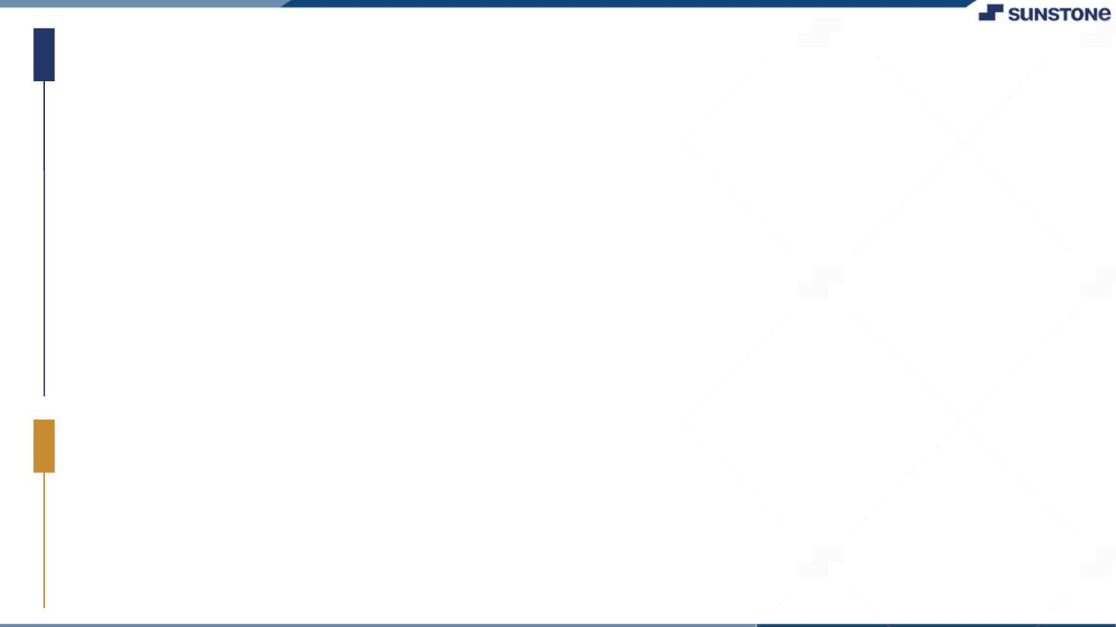
Task - 2
Create UI and implement various components using react
Split design into components and Higher order Components
Define structure of the components
Set the basic ui components with dummy data
●
●
●
Integrate the APIs to frontend to ensure the dynamic feature of website
Point base api to the severs base url
Design api calls for each element
Handle errors in the output
Render output of apis to different low level components
Secure content of post apisx
●
●
●
●
●
Evaluation Metric:
● 100% Completion of the above tasks
Learning Outcome
▪
▪
▪
▪
Developing complicated UI using react components
Using props drilling and context to pass variables
Getting familiar with different type of api calls
Handling different input data

Slide 4

Step-Wise Description
Inventory Tracking System: Implement an inventory tracking system, such as inventory management software or an e-commerce platform with inventory management features. This system should help you keep track of your products, their quantities, and their status (in stock, out of stock, etc.).
Categorize Your Products: Group your grocery items into categories like fresh produce, dairy, meat, canned goods, etc. This helps you organize your inventory and makes it easier for customers to find products.
Set Par Levels: Determine the minimum and maximum stock levels for each product. When the stock falls below the minimum level, it should trigger a reorder.
Replenishment System: Implement a system that automatically reorders products when they reach the minimum stock level. This can be integrated with your suppliers or wholesalers.
Supplier Relationships: Establish strong relationships with your suppliers. Communicate your inventory needs, lead times, and quality expectations. Reliable suppliers are crucial to maintaining a well-stocked inventory.
Real-time Inventory Updates: Ensure your inventory system provides real-time updates on product availability. Customers should see accurate stock levels on your website to prevent over-selling.
Batch and Expiry Tracking: Especially important for perishable items, track the batch and expiry dates of products. This helps prevent selling expired or spoiled goods.
First-In, First-Out (FIFO): Implement a FIFO system to ensure older products are sold first. This minimizes waste and helps maintain product freshness.
Summary of your task
A Grocery shop plays a fundamental role in providing essential food and household items to the community. The success of a grocery shop relies on effective inventory management,quality products,competitive pricing,and excellent customer service.

Slide 5
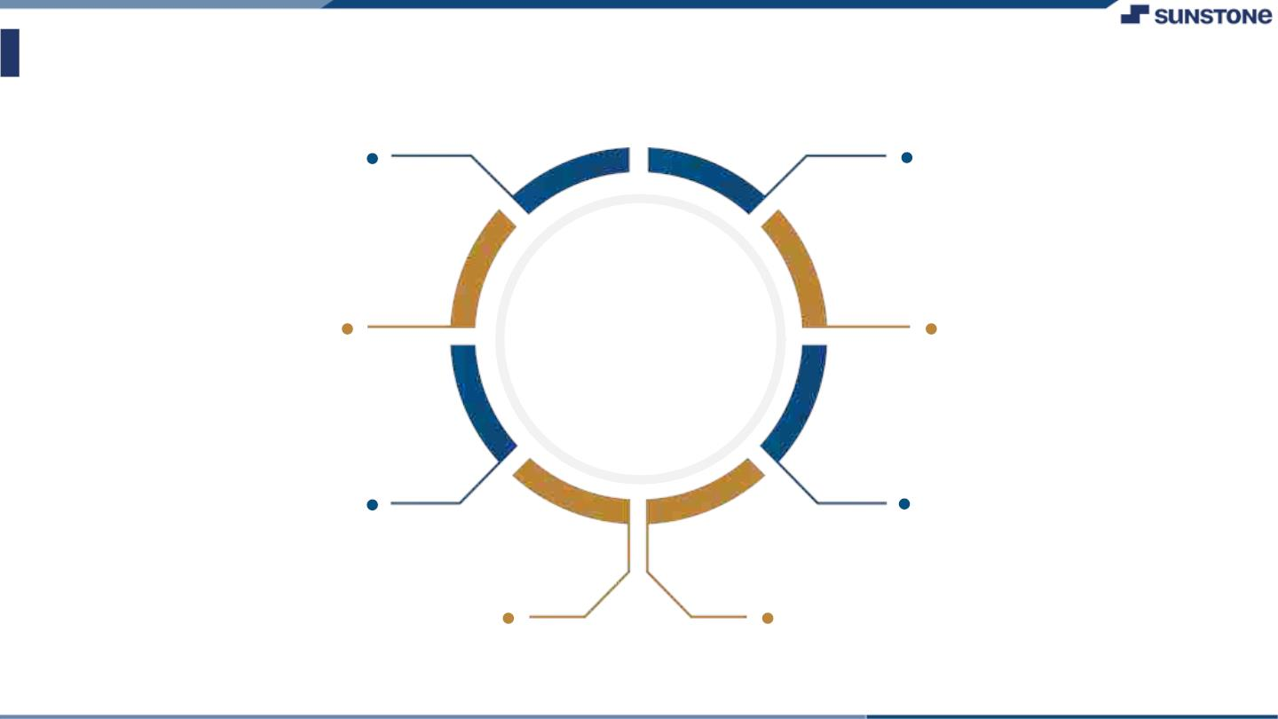
Assessment Parameter
Gather requirements for the
project
Add Readme.md file with description of the project
Prepare database design
schemas
Check-List
Commit all changes with "first commit"
Get your initial project
Structure ready
Create a repository on github realted to project
Initiate a
Initiate a git repository
Push your changes to github

Slide 6
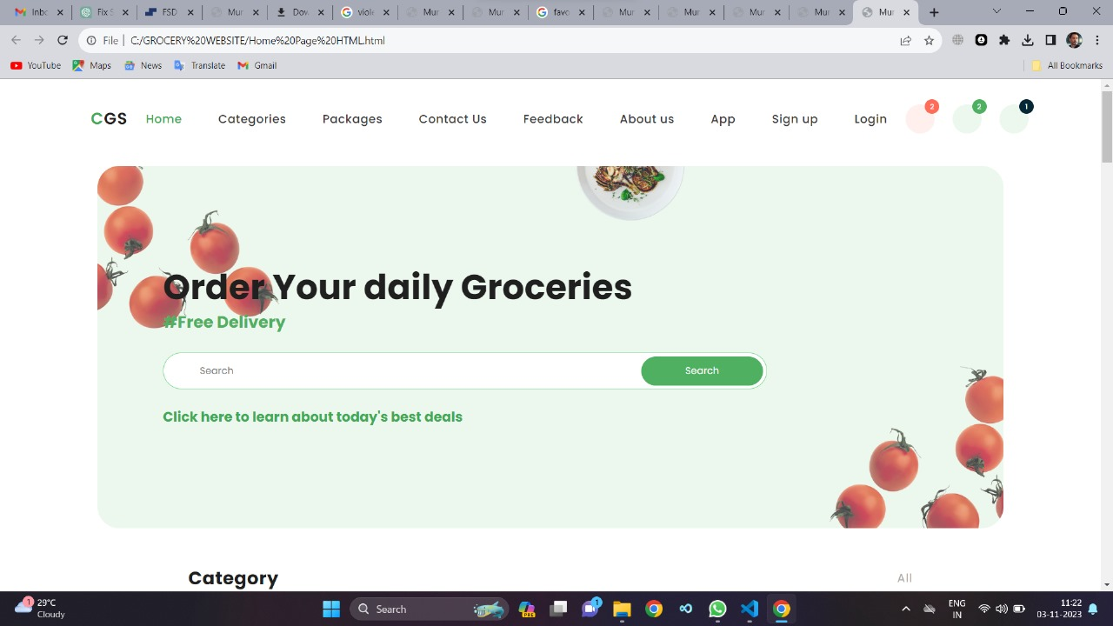

Slide 7
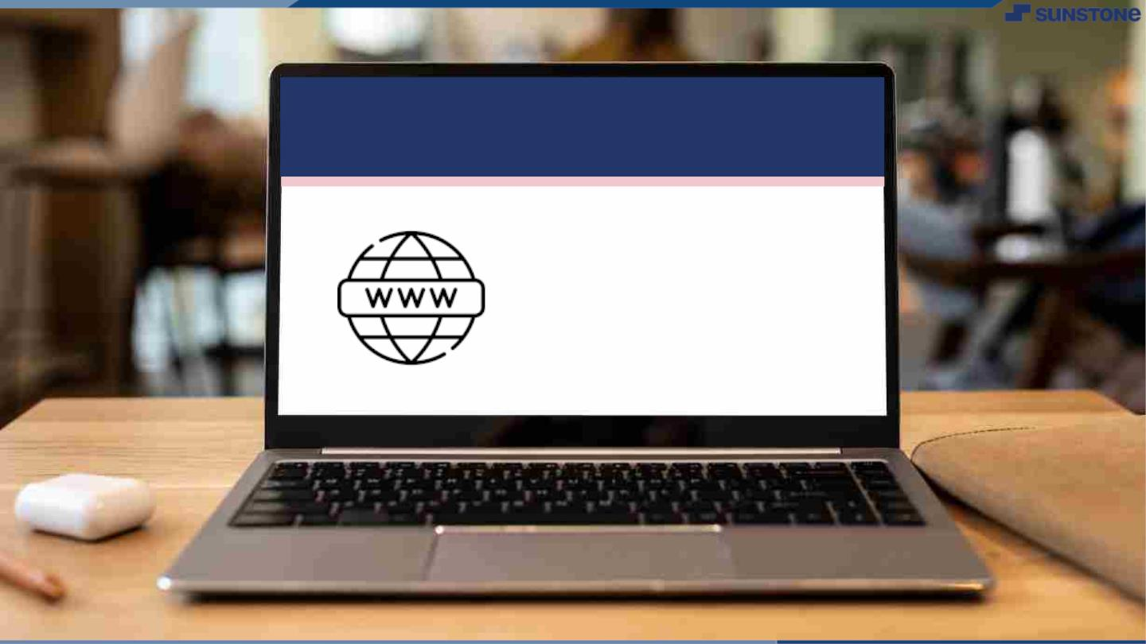
Submission Github
https://github.com/harihara143/naanmudhalvan

Slide 8


